Slide 1
Basic Statistics Probability Distributions

Slide 2
Topics
Random Variables
Probability Distribution
Normal Distribution
Log-Normal Distribution
Chi-Square Distribution
F-Distribution
Weibull Distribution
Student’s t-Distribution
The Central Limit Theorem

Slide 3
Random Variables…
A random variable is a function or rule that assigns a number to each outcome of an experiment. Basically it is just a symbol that represents the outcome of an experiment.
X = number of heads when the experiment is flipping a coin 20 times.
C = the daily change in a stock price.
R = the number of miles per gallon you get on your auto during a family vacation.
Y = the amount of medication in a blood pressure pill.
V = the speed of an auto registered on a radar detector used on I-20

Slide 4
Two Types of Random Variables…
Discrete Random Variable – usually count data [Number of]
* one that takes on a countable number of values – this means you can sit down and list all possible outcomes without missing any, although it might take you an infinite amount of time.
X = values on the roll of two dice: X has to be either 2, 3, 4, …, or 12.
Y = number of accidents on the UTA campus during a week: Y has to be 0, 1, 2, 3, 4, 5, 6, 7, 8, ……………”real big number”
Continuous Random Variable – usually measurement data [time, weight, distance, etc]
* one that takes on an uncountable number of values – this means you can never list all possible outcomes even if you had an infinite amount of time.
X = time it takes you to drive home from class: X > 0, might be 30.1 minutes measured to the nearest tenth but in reality the actual time is 30.10000001…………………. minutes?)
Exercise: try to list all possible numbers between 0 and 1.

Slide 5

Probability Distribution
A probability distribution function (pdf) describes the space of the event and the probability of the occurrence of each event
Discrete distributions have the pdf’s defined at each event
Continuous distributions have their pdf’s defined by the cumulative density function’s (cdf) which describe the probability of a space rather than a single event
Similarly discrete random variable is a random variable from a discrete distribution and continuous random variable come from a continuous distribution
All distributions could be explained by a single Moment Generating Function (mgf)
It is extremely important to study these distributions since these are more frequently physically encountered curves and studied/understood well so inferences could be drawn from them

Slide 6
Probability Distributions type
A probability distribution (density function) is a table, formula, or graph that describes the values of a random variable and the probability associated with these values.
– Discrete Probability Distribution
X = outcome of rolling one die
– Continuous Probability Distribution

Slide 7
Probability functions
A probability function maps the possible values of x against their respective probabilities of occurrence, p(x)
p(x) is a number from 0 to 1.0.
The area under a probability function is always 1.
Notes:
It turns out that if you were to go out and sample many, many times, most sample statistics that you could calculate would follow a normal distribution.
What are the 2 parameters (from last time) that define any normal distribution?
Remember that a normal curve is characterized by two parameters, a mean and a variability (SD)
What do you think the mean value of a sample statistic would be? The standard deviation?
Remember standard deviation is natural variability of the population
Standard error can be standard error of the mean or standard error of the odds ratio or standard error of the difference of 2 means, etc. The standard error of any sample statistic.

Slide 8
Discrete example: roll of a die
p(x)
1/6
x
1
2
3
4
5
6

Slide 9
Probability mass function (pmf)
x
p(x)
1
p(x=1)=1/6
2
p(x=2)=1/6
3
p(x=3)=1/6
4
p(x=4)=1/6
5
p(x=5)=1/6
6
p(x=6)=1/6
1.0

Slide 10
Cumulative distribution function (CDF)
1.0
P(x)
5/6
2/3
1/2
1/3
1/6
1
2
3
4
5
6
x

Slide 11
Cumulative distribution function
x
P(x≤A)
1
P(x≤1)=1/6
2
P(x≤2)=2/6
3
P(x≤3)=3/6
4
P(x≤4)=4/6
5
P(x≤5)=5/6
6
P(x≤6)=6/6

Slide 12
Probability Distribution : Two dimensions
Dice1 Dice2 | 1 | 2 | 3 | 4 | 5 | 6
1 | 2 | 3 | 4 | 5 | 6 | 7
2 | 3 | 4 | 5 | 6 | 7 | 8
3 | 4 | 5 | 6 | 7 | 8 | 9
4 | 5 | 6 | 7 | 8 | 9 | 10
5 | 6 | 7 | 8 | 9 | 10 | 11
6 | 7 | 8 | 9 | 10 | 11 | 12

Slide 13
“Probability Distribution” (contd.)
Discrete values
Discrete values
Values of x are discrete (discontinuous)
Sum of lengths of vertical bars Σp(X=x) = 1
all x

Slide 14
Practice Problem:
The number of patients seen in the ER in any given hour is a random variable represented by x. The probability distribution for x is:
x
10
11
12
13
14
P(x)
.4
.2
.2
.1
.1
Find the probability that in a given hour:
a. exactly 14 patients arrive
b. At least 12 patients arrive
c. At most 11 patients arrive
p(x=14)= .1
p(x≥12)= (.2 + .1 +.1) = .4
p(x≤11)= (.4 +.2) = .6

Slide 15
Review Question
If you toss a die, what’s the probability that you roll a 3 or less?
1/6
1/3
1/2
5/6
1.0
Two dice are rolled and the sum of the face values is six? What is the probability that at least one of the dice came up a 3?
1/5
2/3
1/2
5/6
1.0
Two dice are rolled and the sum of the face values is six. What is the probability that at least one of the dice came up a 3?
1/5
2/3
1/2
5/6
1.0
How can you get a 6 on two dice? 1-5, 5-1, 2-4, 4-2, 3-3
One of these five has a 3.
∴1/5

Slide 16
Continuous case
The probability function that accompanies a continuous random variable is a continuous mathematical function that integrates to 1.
For example, recall the negative exponential function (in probability, this is called an “exponential distribution”):
This function integrates to 1:

Slide 17
Continuous case: “probability density function” (pdf)
p(x)=e^{-x}
1
x
The probability that x is any exact particular value (such as 1.9976) is 0; we can only assign probabilities to possible ranges of x.

Slide 18
For example, the probability of x falling within 1 to 2:
Clinical example: Survival times after lung transplant may roughly follow an exponential function.
Then, the probability that a patient will die in the second year after surgery (between years 1 and 2) is 23%.
p(x)=e^{-x}
1
x
1
2

Slide 19
Uniform distribution
The uniform distribution: all values are equally likely.
f(x)= 1 , for 1≥ x ≥0
p(x)
1
x
1
We can see it’s a probability distribution because it integrates to 1 (the area under the curve is 1):

Slide 20
Example: Uniform distribution
What’s the probability that x is between 0 and ½?
p(x)
Clinical Research Example: When randomizing patients in an RCT, we often use a random number generator on the computer. These programs work by randomly generating a number between 0 and 1 (with equal probability of every number in between). Then a subject who gets X<.5 is control and a subject who gets X>.5 is treatment.
1
0
½
x
1
P(½ ≥x≥ 0)= ½

Slide 21
Expected value of a random variable
Expected value is just the average or mean (µ) of random variable x.
It’s sometimes called a “weighted average” because more frequent values of X are weighted more highly in the average.
It’s also how we expect X to behave on-average over the long run (“frequentist” view again).

Slide 22
Expected value, formally
Discrete case:
Continuous case:

Slide 23
Example: expected value
Recall the following probability distribution of ER arrivals:
x
10
11
12
13
14
P(x)
.4
.2
.2
.1
.1

Slide 24
Sample Mean is a special case of Expected Value…
Sample mean, for a sample of n subjects: =
The probability (frequency) of each person in the sample is 1/n.

Slide 25
Binomial Probability Distribution
A fixed number of observations (trials), n
e.g., 15 tosses of a coin; 20 patients; 1000 people surveyed
A binary outcome
e.g., head or tail in each toss of a coin; disease or no disease
Generally called “success” and “failure”
Probability of success is p, probability of failure is 1 – p
Constant probability for each observation
e.g., Probability of getting a tail is the same each time we toss the coin

Slide 26
Binomial distribution function: X= the number of heads tossed in 5 coin tosses
p(x)
p(x)
x
0
1
2
3
4
5
number of heads
number of heads

Slide 27
Binomial distribution, generally
Note the general pattern emerging → if you have only two possible outcomes (call them 1/0 or yes/no or success/failure) in n independent trials, then the probability of exactly X “successes”=
n = number of trials
1-p = probability of failure
X = # successes out of n trials
p = probability of success

Slide 28
Binomial distribution: example
If I toss a coin 20 times, what’s the probability of getting exactly 10 heads?

Slide 29
Binomial distribution: example
If I toss a coin 20 times, what’s the probability of getting of getting 2 or fewer heads?

Slide 30
**All probability distributions are characterized by an expected value and a variance:
If X follows a binomial distribution with parameters n and p: X ~ Bin (n, p)
Then:
E(X) = np
Var (X) = np(1-p)
SD (X)=
Note: the variance will always lie between
0*N-.25 *N
p(1-p) reaches maximum at p=.5
P(1-p)=.25

Slide 31
Stats for proportions
For binomial:
Differs by a factor of n.
Differs by a factor of n.
For proportion:
P-hat stands for “sample proportion.”

Slide 32
Practice Problem
1. You are performing a cohort study. If the probability of developing disease in the exposed group is .05 for the study duration, then if you (randomly) sample 500 exposed people, how many do you expect to develop the disease? Give a margin of error (+/- 1 standard deviation) for your estimate.
2. What’s the probability that at most 10 exposed people develop the disease?

Slide 33
Answer
1. How many do you expect to develop the disease? Give a margin of error (+/- 1 standard deviation) for your estimate.
X ~ binomial (500, .05)
E(X) = 500 (.05) = 25
Var(X) = 500 (.05) (.95) = 23.75
StdDev(X) = square root (23.75) = 4.87
∴25 ± 4.87

Slide 34
Answer
2. What’s the probability that at most 10 exposed subjects develop the disease?
This is asking for a CUMULATIVE PROBABILITY: the probability of 0 getting the disease or 1 or 2 or 3 or 4 or up to 10.
P(X≤10) = P(X=0) + P(X=1) + P(X=2) + P(X=3) + P(X=4)+….+ P(X=10)=

Slide 35
Practice Problem:
You are conducting a case-control study of smoking and lung cancer. If the probability of being a smoker among lung cancer cases is .6, what’s the probability that in a group of 8 cases you have:
Less than 2 smokers?
More than 5?
What are the expected value and variance of the number of smokers?

Slide 36
Answer
0
1
2
3
4
5
6
7
8

Slide 37
Answer, continued
P(<2)=.00065 + .008 = .00865
P(>5)=.21+.09+.0168 = .3168
0
1
2
3
4
5
6
7
8
E(X) = 8 (.6) = 4.8
Var(X) = 8 (.6) (.4) =1.92
StdDev(X) = 1.38

Slide 38



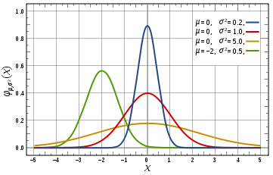
Normal Distribution
Pdf
Mean μ
Median μ
Mode μ
Cdf
Variance σ²
Moment Generating function
Changing the mean varies the peak position on the x axis
Decreasing the variance moves the peak up and narrows down the shape
Characteristics:
Symmetric about the mean μ
If X₁ (μ₁, σ₁)and X₂ (μ₂, σ₂)are two independent Normal Random Variables then
Standardization of curve implies N(0,1) is done by substituting Z=(X -μ)/σ
About 68% values are within one Std Dev, 95% within two and 99.7% within 3

Slide 39



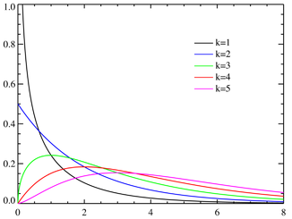


Chi-Square Distribution
Pdf
Mean k
Median
Mode max(k-2,0)
Cdf
Variance 2k
Moment Generating function
for t<=1/2
Higher the mean Chi-Square resembles more to a Normal Distribution
Distribution of sum of squares of k independent random variables from a normal distribution
Characteristics:
If are independent chi-squared variables with then ∑ is also chi-square distribution with ∑ degree of freedom
if are iid N(μ,σ²) random variables, then where
If X is chi-square distributed, then X^{1/2} is chi distributed

Slide 40





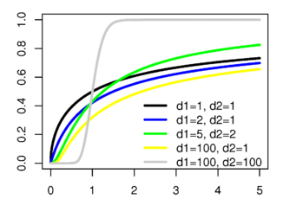

F Distribution
Pdf
Mean
Median NA
Mode
Cdf
Variance
Moment Generating function
d₂>2
d₂>4
d₁>2
Not Defined
Higher the mean -> Lower d₂ implies lower height of the curve. Higher the value of d1 lower is the average slope near the origin
Distribution of ratio of two Chi-Squared variates
Characteristics:
Forms the basis of F Test statistic

Slide 41


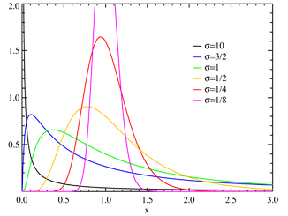
Log-Normal Distribution
Pdf
Mean
Median
Mode
Cdf
Variance
Moment Generating function
Defined partially on –ve axis
Very similar in behavior to Normal distribution
Distribution for product of independent random variables
Characteristics:
Geometric Mean and standard deviation are e^{μ} and e^{σ}

Slide 42





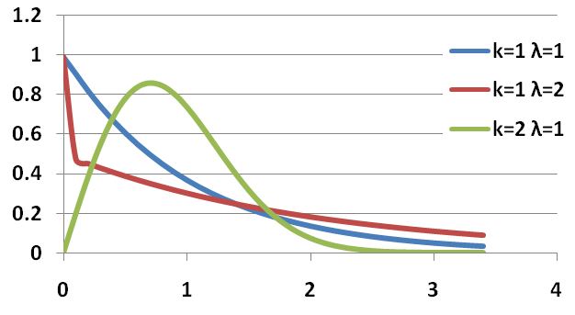

Weibull Distribution
Pdf
Mean
Median
Mode
Cdf
Variance
Moment Generating function
k governs the peak of the curve and λ governs the position of the peak
Characterized by a random variables such that the random variable is given by
Characteristics:
k>0 is called the shape parameter and λ the scale parameter
Distribution changes dramatically as shape parameter varies between 0 and 3
It is a special case of Exponentiated Weibull which may assume Unimodal, Bathtub shaped or monotone failure rates

Slide 43



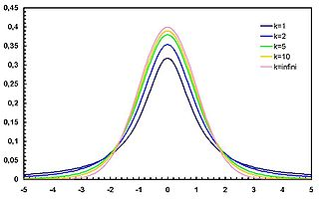

Student’s-t Distribution
Pdf
Mean 0 for ν > 1, otherwise undefined
Median 0
Mode 0
Cdf
Variance
Moment Generating function
If ν<2 then undefined
Not Defined
k governs the peak of the curve and λ governs the position of the peak
Characterized by a random variables such that where V is chi-square distributed and Z~N(0,1)
Characteristics:
pdf of the t-distribution resembles a bell curve but is broader at the base
Forms the basis of t-tests

Slide 44
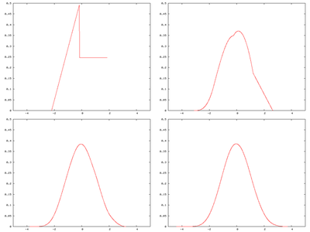
Central Limit Theorem
Second Fundamental theory of probability
X₁, X₂, X₃, …, X_{n} ~ independent and identically distributed random numbers
Central Limit Theorem states that the summation of such random numbers would eventually lead to a normal distribution

Slide 45
Assignments
1. Molly earned a score of 940 on a national achievement test. The mean test score was 850 with a standard deviation of 100. What proportion of students had a higher score than Molly? (Assume that test scores are normally distributed.)
2. An average light bulb manufactured by the Acme Corporation lasts 300 days with a standard deviation of 50 days. Assuming that bulb life is normally distributed, what is the probability that an Acme light bulb will last at most 365 days?
3. Acme Corporation manufactures light bulbs. The CEO claims that an average Acme light bulb lasts 300 days. A researcher randomly selects 15 bulbs for testing. The sampled bulbs last an average of 290 days, with a standard deviation of 50 days. If the CEO's claim were true, what is the probability that 15 randomly selected bulbs would have an average life of no more than 290 days?

Slide 46
Assignments
4. Suppose scores on an IQ test are normally distributed, with a mean of 100. Suppose 20 people are randomly selected and tested. The standard deviation in the sample group is 15. What is the probability that the average test score in the sample group will be at most 110?
5. The Acme Battery Company has developed a new cell phone battery. On average, the battery lasts 60 minutes on a single charge. The standard deviation is 4 minutes.
6. Let's revisit the problem presented above. The manufacturing department ran a quality control test, using 7 randomly selected batteries. In their test, the standard deviation was 6 minutes, which equated to a chi-square statistic of 13.5.
7. Suppose you randomly select 7 women from a population of women, and 12 men from a population of men. The table below shows the standard deviation in each sample and in each population.

